Slide 1

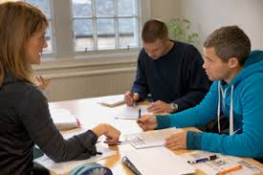

FCE SPEAKING
Tuesday March 10th 19:00 - 20:00
Are you studying for
the First Certificate?
Come along to our speaking
Practice session!
Speaking exam practice and helpful
advice for the oral part of the exam
Sign up at reception - limited places are available

